Slide 1
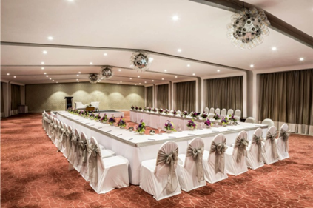
BANQUETS
Presented by
Urmi Das
Faculty
B.Voc (CTHM)

Slide 2
Types of banquet functions:
1.Statebanquets,formal functions/dinner
2.Reception
3.Buffets
4.Conference and convection
5.Theme banquets

Slide 3
Types of Banquets:
INFORMAL: Sitting ,Room. get together, festivals
FORMAL : Raising day Flag Day, National Day
SEMI-FORMAL: Institutional functions ,Annual Day functions

Slide 4
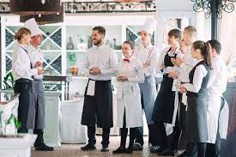
Banquet of staffing
Banquet manager
Assistant manager
Maitre D’Hote
Waiter
Porters

Slide 5
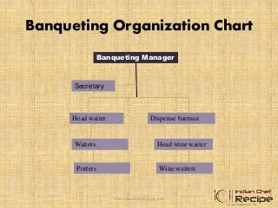

Slide 6
Sequence of service
Welcome drinks
Snacks &other appetizers
Soup service
Main course buffet/self service
Sweets /Desserts
Coffee/Tea

Slide 7


